Slide 1



BIOMETRIC STUDENT ATTENDANCE
Presented by: GROUP 5

Slide 2
REQUIREMENTS GATHERING
Presented by: GROUP 5

Slide 3
OUTLINE
01
02
03
04
Introduction
Objective and Goal
Business Need
stakeholders
04
05
06
07
Functional Requirements
Non-functional Requirements
Constraints and Consideration
requirements and prioritization

Slide 4



INTRODUCTION
In today's tech-driven classrooms, wasting time on roll call is outdated. Biometric student attendance app streamlines attendance with secure fingerprint technology, freeing up valuable teaching minutes for educators. Let's explore key features that make this app user-friendly and adaptable for all schools, ultimately revolutionizing attendance tracking.

Slide 5
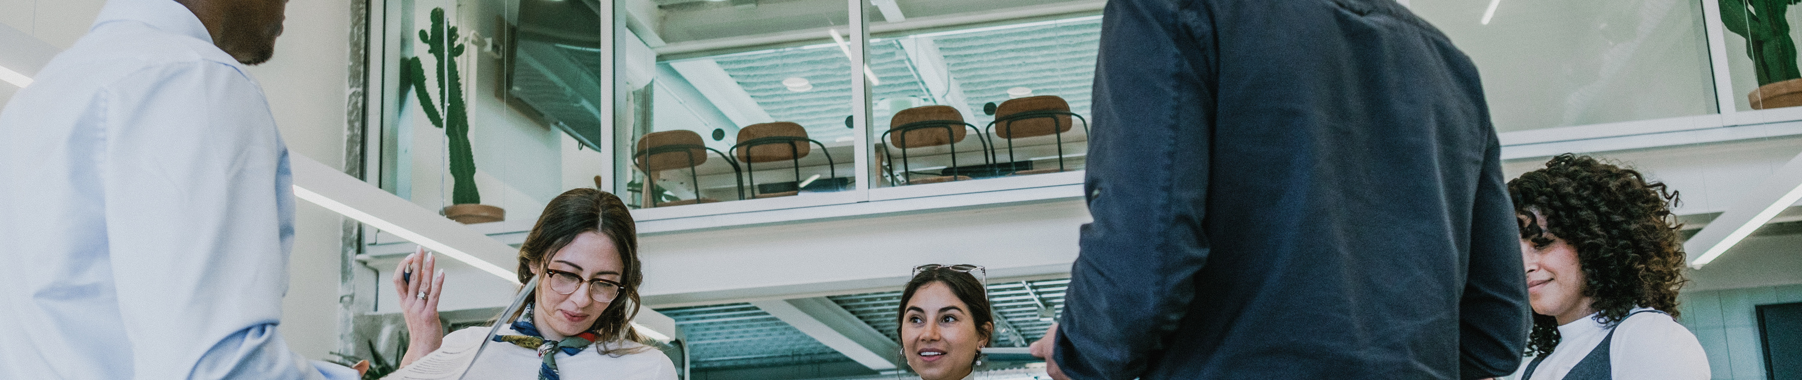
OBJECTIVES AND GOAL
Objective
The objective of this project is to develop a secure and user-friendly mobile application that leverages fingerprint recognition technology for student attendance tracking in educational institutions.
Goal
The goal of this project is to revolutionize attendance tracking in schools and contribute to a more efficient and effective learning environment.

Slide 6





BUSINESS NEED
01
Operating environment:
mobile platform (IOS/Android)
network connectivity
02
Product features:
biometric authentication
attendance marking
real-time synchronization
03
Design and Implementation constraint:
security consideration
compatibilty
04
User need and documentation:
register into the system
each student mark their present
track student attendance

Slide 7




USER PERSONA
Our target audience is instructors who are frustrated with the time-consuming and error-prone process of traditional attendance methods. They crave a system that's quick, accurate, and provides real-time data to identify at-risk students. Ideally, this seamless solution would minimize disruption to the flow of their lessons.
Olivier
Wilson
instructor

Slide 8


STAKEHOLDERS
kenne suzy
Claude Alves
olivier wilson
student
administrator
instructor

Slide 9

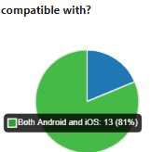
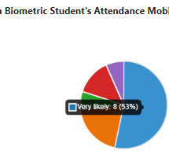
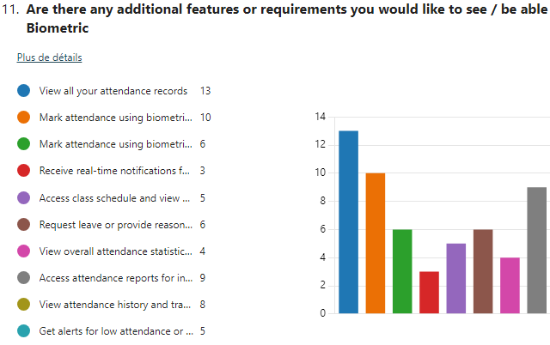



SURVEYS
The following shows in detail what we got as answers and we noticed that people were very engage when filling out the form, in average 05:24 minutes to fill the form for 15 answers. Following are screenshots of the result.
Project 2

Slide 10



INTERVIEWS
80%
desires a reliable efficient , and secure biometric application that streamlines the process of taking attendance, eliminates errors, and provides real-time data.
20%
desires a biometric attendance application that deal with face recognition instead of fingerprint.

Slide 11

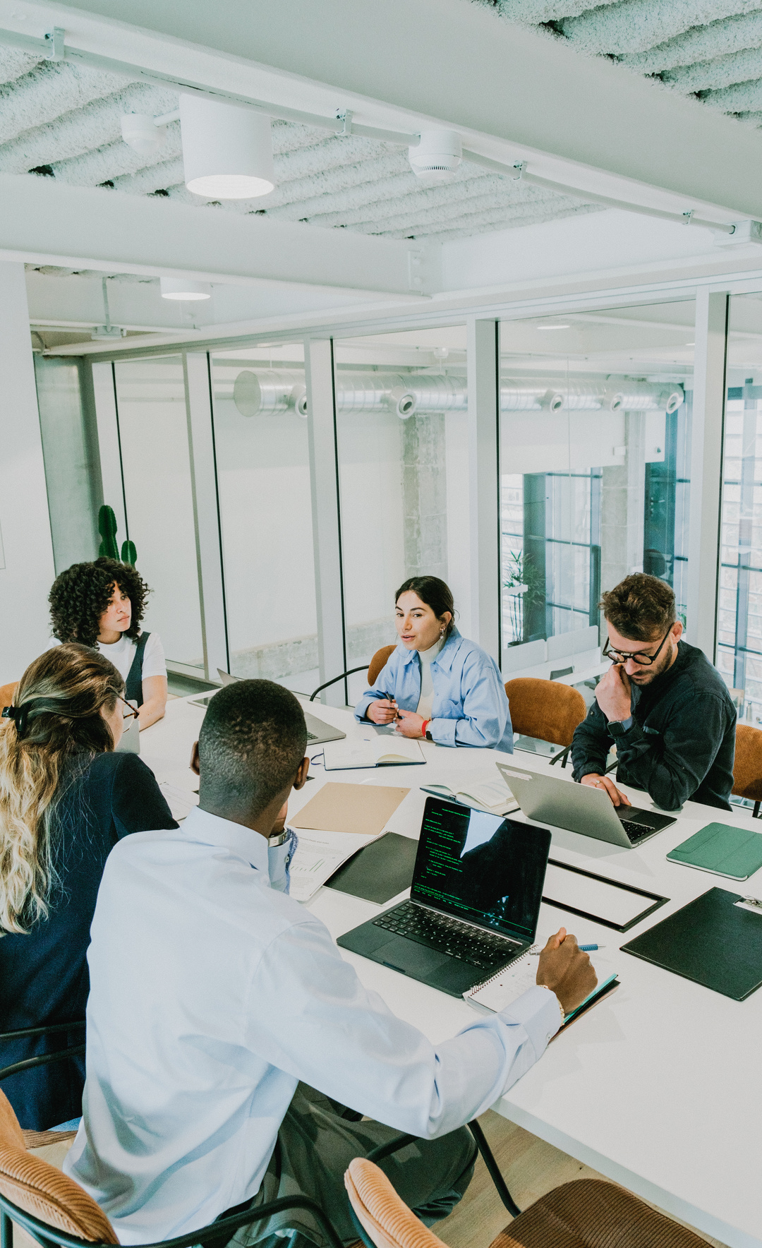




FUNCTIONAL REQUIREMENTS
User management
attendance marking
view attendance data records
biometric authentication

Slide 12
NON-FUNCTIONAL REQUIREMENTS
Performance
Usability
reliability
security
maintainability
portability
scalability

Slide 13
CONSTRAINTS AND CONSIDERATION
Compliance: The biometric system should adhere to any legal and regulatory requirements about the collection and usage of biometric data.
Hardware Compatibility: The system should be compatible with a range of biometric devices and sensors available on the market.
Integration: The system should seamlessly integrate with existing university systems, such as student information systems or learning management systems, to streamline attendance management processes.

Slide 14
REQUIREMENT DOCUMENTATION AND PRIORITIZATION
functional requirements
non-functional requirements
user specific requirements

Slide 15

Thank you

